Slide 1
Laplace Transforms

Slide 2
Laplace Transform
Bilateral
L

Slide 3
Inverse Laplace Transform

Slide 4
Inverse Laplace Transform
We will not use this formula for inverse

Slide 5
Example 9.1

Slide 6

Example 9.1
$$Re\left\{s\right\}>−a$$

Slide 7
Example 9.1
L

Slide 8
Example 9.1
L
If a = 2
s-plane
-2

Slide 9
Example 9.1
L
If a = 2
s-plane
ROC (Region of Convergence)
-2

Slide 10
Example 9.2

Slide 11
Example 9.2
L
ROC
-2

Slide 12
Importance of ROC
L
L

Slide 13
Importance of ROC
L
right
right
L
left
left

Slide 14
Example 9.3
L

Slide 15
Example 9.3
L

Slide 16
Example 9.3
L

Slide 17
Example 9.3
L
&

Slide 18
Example 9.3
L

Slide 19
Example 9.3
L
Im
s-plane
Re
-2
-3/2
-1

Slide 20
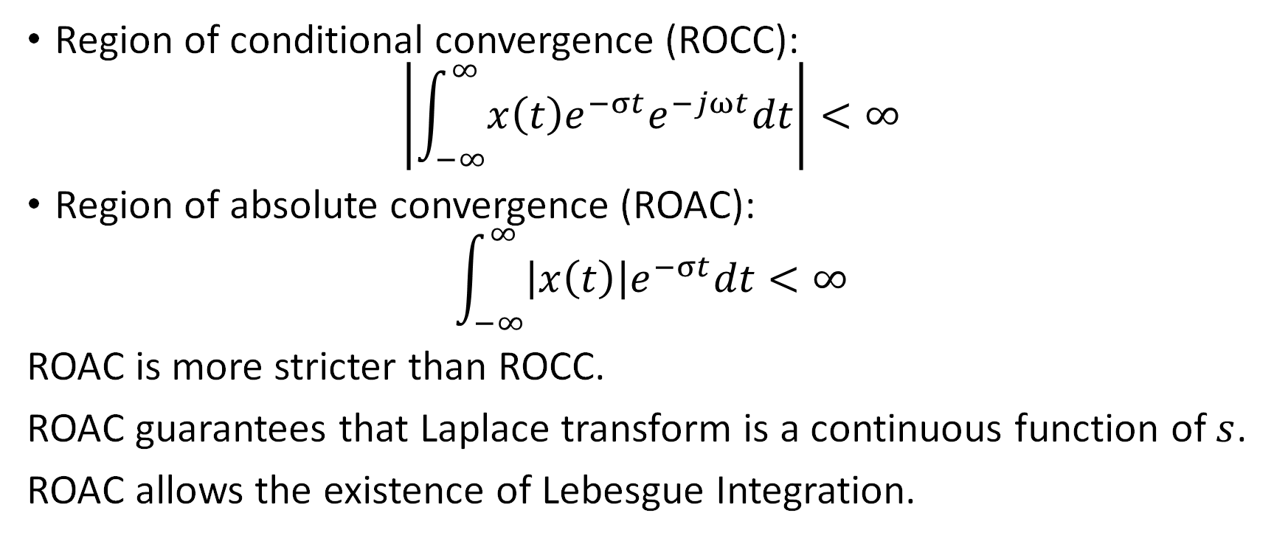
Region of convergence
Region of conditional convergence (ROCC):
$$\left|\int_{−∞}^{∞}{x\left(t\right)e^{−σt}e^{−jωt}dt}\right|<∞$$
Region of absolute convergence (ROAC):
$$\int_{−∞}^{∞}{\left|x\left(t\right)\right|e^{−σt}dt}<∞$$
ROAC is more stricter than ROCC.
ROAC guarantees that Laplace transform is a continuous function of $s$.
ROAC allows the existence of Lebesgue Integration.

Slide 21
Laplace transform as a rational function
Describe linear-constant coefficient differential equation
Zeros of X(s)
ROC does not contain poles
Poles of X(s)

Slide 22
Properties of the Region of Convergence
The ROC contains no poles
  Poles of X(s) are where D(s) = 0

Slide 23
Properties of the Region of Convergence
The ROC contains no poles
  Poles of X(s) are where D(s) = 0
The ROC of X(s) consists of a strip parallel to the jω-axis in the s-plane

Slide 24
Properties of the Region of Convergence
The ROC contains no poles
  Poles of X(s) are where D(s) = 0
The ROC of X(s) consists of a strip parallel to the jω-axis in the s-plane
F{x(t)} converges implies ROC includes the jω-axis in the s-plane

Slide 25
Properties of the Region of Convergence
If x(t) is of finite duration
  -ROC is entire s-plane, except possibly at infinity.
Decaying exponential
T1
T2

Slide 26
Properties of the Region of Convergence
If x(t) is of finite duration
  -ROC is entire s-plane, except possibly at infinity.
Growing exponential
T1
T2

Slide 27
Properties of the Region of Convergence
If x(t) is right-sided
  -If is in ROC, then is also in ROC
T1
∞

Slide 28
Properties of the Region of Convergence
If x(t) is right-sided
  -If is in ROC, then is also in ROC
If x(t) is right-sided and non-causal
  Then + Infinity is not in ROC.
T1
∞

Slide 29
Properties of the Region of Convergence
If x(t) is right-sided
  -If is in ROC, then is also in ROC
If x(t) is right-sided and X(s) is rational
  -ROC lies to the right of the rightmost pole, except may be excluding + Infinity.
T1
∞

Slide 30
Properties of the Region of Convergence
If x(t) is left-sided and Re{s} = is in ROC
  -all values for which are in ROC, except may be excluding (-) Infinity.

Slide 31
Properties of the Region of Convergence
If x(t) is left-sided and Re{s} = is in ROC
  -all values for which are in ROC , except may be excluding (-) Infinity.
If x(t) is left-sided and X(s) is rational
  -ROC lies to the left of the leftmost pole , except may be excluding (-) Infinity.

Slide 32
Properties of the Region of Convergence
If x(t) is left-sided and Re{s} = is in ROC
  -all values for which are in ROC , except may be excluding (-) Infinity.
If x(t) is left-sided and X(s) is rational
  -ROC lies to the left of the leftmost pole , except may be excluding (-) Infinity.
If x(t) is two-sided and is in ROC
  -ROC is a strip in the s-plane

Slide 33
Properties of the Region of Convergence
The ROC is a connected region
  It cannot have multiple strips
Im
s-plane
Re
-2
-1

Slide 34
Properties of the Region of Convergence
The ROC is a connected region
  It cannot have multiple strips
Im
s-plane
Re
-2
-1

Slide 35
Properties of the Region of Convergence
The ROC is a connected region
  It cannot have multiple strips
Im
s-plane
Re
-2
-1

Slide 36
Properties of the Region of Convergence
The ROC is a connected region
  It cannot have multiple strips
Im
s-plane
Re
-2
-1

Slide 37
Properties of the Region of Convergence
The ROC is a connected region
  It cannot have multiple strips
Im
s-plane
NOT A VALID ROC
Re
-2
-1

Slide 38
Inverse Laplace Transform
I
II
III
IV
Im
s-plane
Re

Slide 39
Inverse Laplace Transform
I
II
III
IV
Im
s-plane
Re

Slide 40
Inverse Laplace Transform
Im
s-plane
Re

Slide 41
Inverse Laplace Transform
Im
s-plane
Re

Slide 42
Inverse Laplace Transform
I
II
III
IV
Im
s-plane
Re

Slide 43
Inverse Laplace Transform
I
II
III
IV
Im
s-plane
Re

Slide 44


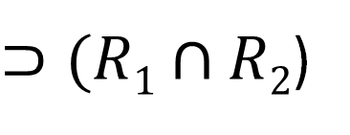
Properties of Laplace Transforms
Linearity
$⊃(R1∩R2$)
$$R$$
Time shifting
$$aR$$
Time scaling

Slide 45



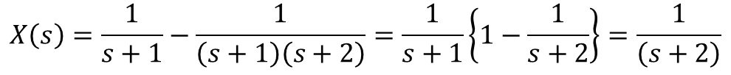


Example:
$$X_{1}\left(s\right)=\frac{1}{s+1}$$
$$X_{2}\left(s\right)=\frac{1}{\left(s+1\right)\left(s+2\right)}$$
$$Re\left\{s\right\}>−1$$
$$Re\left\{s\right\}>−1$$
$$X\left(s\right)=\frac{1}{s+1}−\frac{1}{\left(s+1\right)\left(s+2\right)}=\frac{1}{s+1}\left\{1−\frac{1}{s+2}\right\}=\frac{1}{\left(s+2\right)}$$
$$Re\left\{s\right\}>−2$$

Slide 46


Properties of Laplace Transforms
Multiply by t
$$R$$
Differentiation
in time
$$⊃R$$

Slide 47
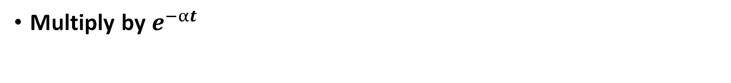
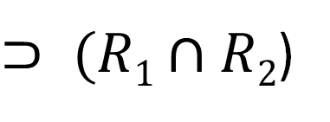

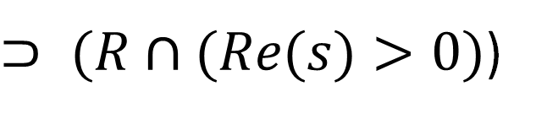
Properties of Laplace Transforms
Multiply by $e^{−αt}$
$$shift R by −α$$
$⊃ (R1∩R2$)
Convolution
Integrate
in time
$⊃ (R∩(Re(s)>0)$)

Slide 48
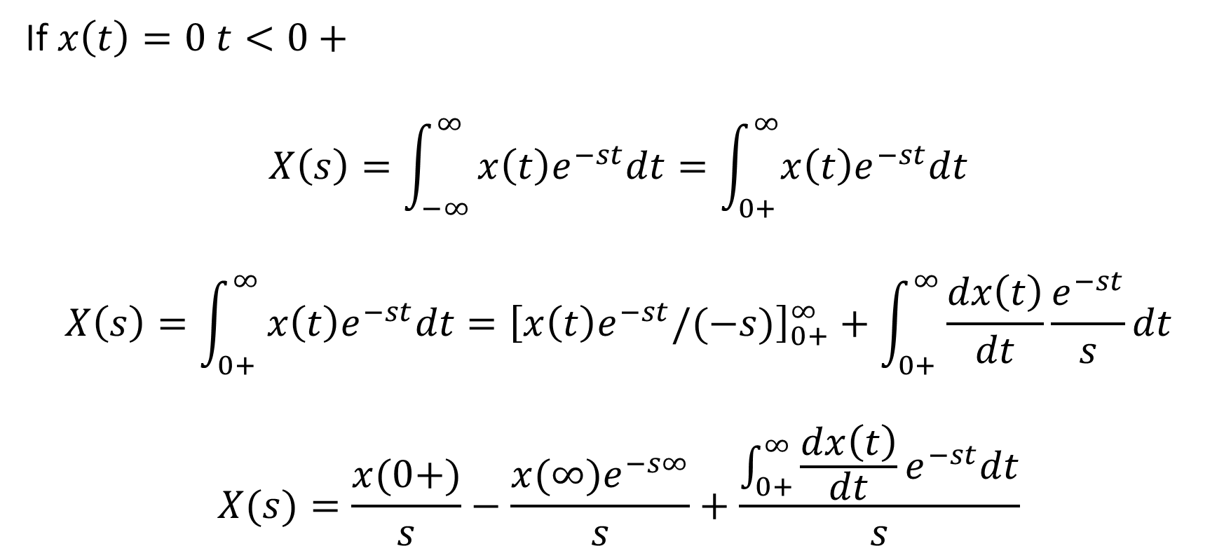
Properties of Laplace Transforms
If $x\left(t\right)=0 t<0+$
$$X\left(s\right)=\int_{−∞}^{∞}{x\left(t\right)e^{−st}dt=\int_{0+}^{∞}{x\left(t\right)e^{−st}dt}}$$
$$X\left(s\right)=\int_{0+}^{∞}{x\left(t\right)e^{−st}dt={\left[x\left(t\right)e^{−st}/(−s)\right]}_{0+}^{∞}+\int_{0+}^{∞}{\frac{dx\left(t\right)}{dt}\frac{e^{−st}}{s}dt}}$$
$$X(s)=\frac{x(0+)}{s}−\frac{{x(∞)e}^{−s∞}}{s}+\frac{\int_{0+}^{∞}{\frac{dx\left(t\right)}{dt}e^{−st}dt}}{s}$$

Slide 49
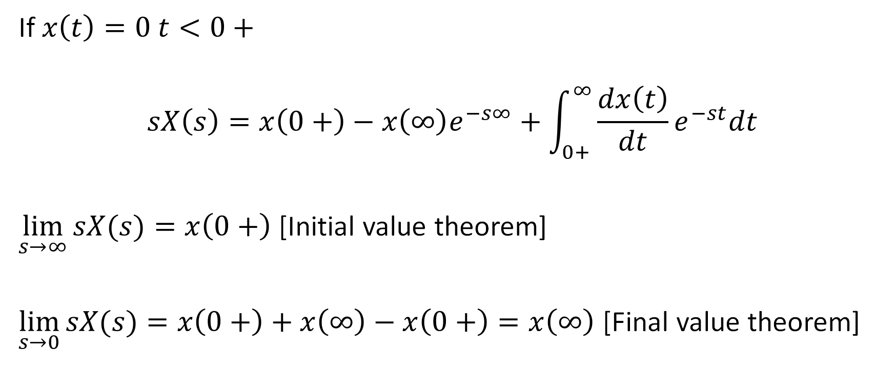
Properties of Laplace Transforms
If $x\left(t\right)=0 t<0+$
$$sX\left(s\right)=x\left(0+\right)−{x\left(∞\right)e}^{−s∞}+\int_{0+}^{∞}{\frac{dx\left(t\right)}{dt}e^{−st}dt}$$
$\lim_{s→∞}{sX(s)}=x\left(0+\right)$ [Initial value theorem]
$\lim_{s→0}{sX(s)}=x\left(0+\right)+x\left(∞\right)−x\left(0+\right)=x\left(∞\right)$ [Final value theorem]

Slide 50
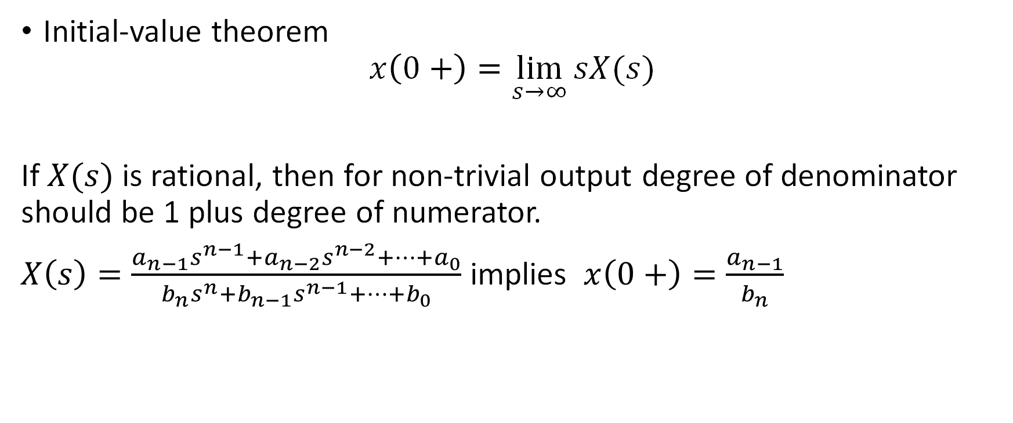
Properties of Laplace Transforms
Initial-value theorem
$$x\left(0+\right)=\lim_{s→∞}{sX(s)}$$
If $X(s)$ is rational, then for non-trivial output degree of denominator should be 1 plus degree of numerator.
$X\left(s\right)=\frac{a_{n−1}s^{n−1}+a_{n−2}s^{n−2}+…+a_{0}}{b_{n}s^{n}+b_{n−1}s^{n−1}+…+b_{0}}$ implies $x\left(0+\right)=\frac{a_{n−1}}{b_{n}}$

Slide 51
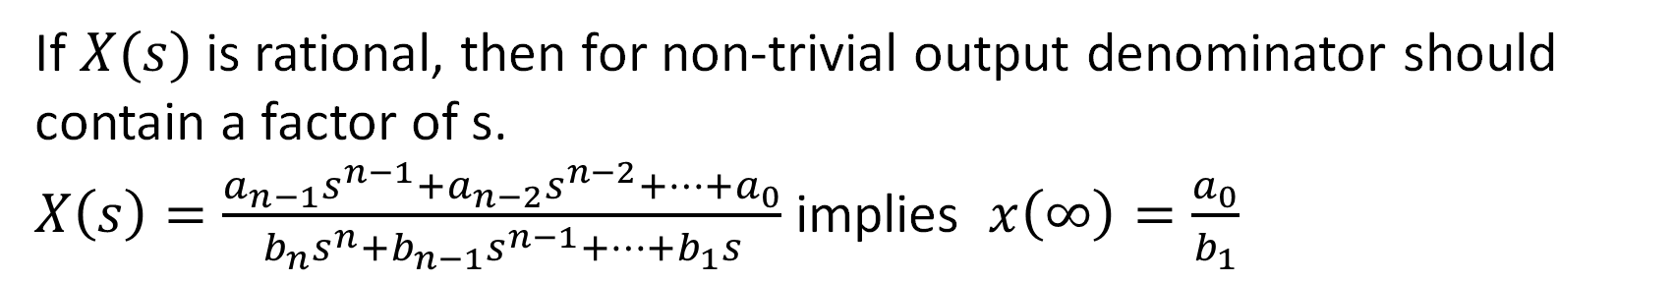
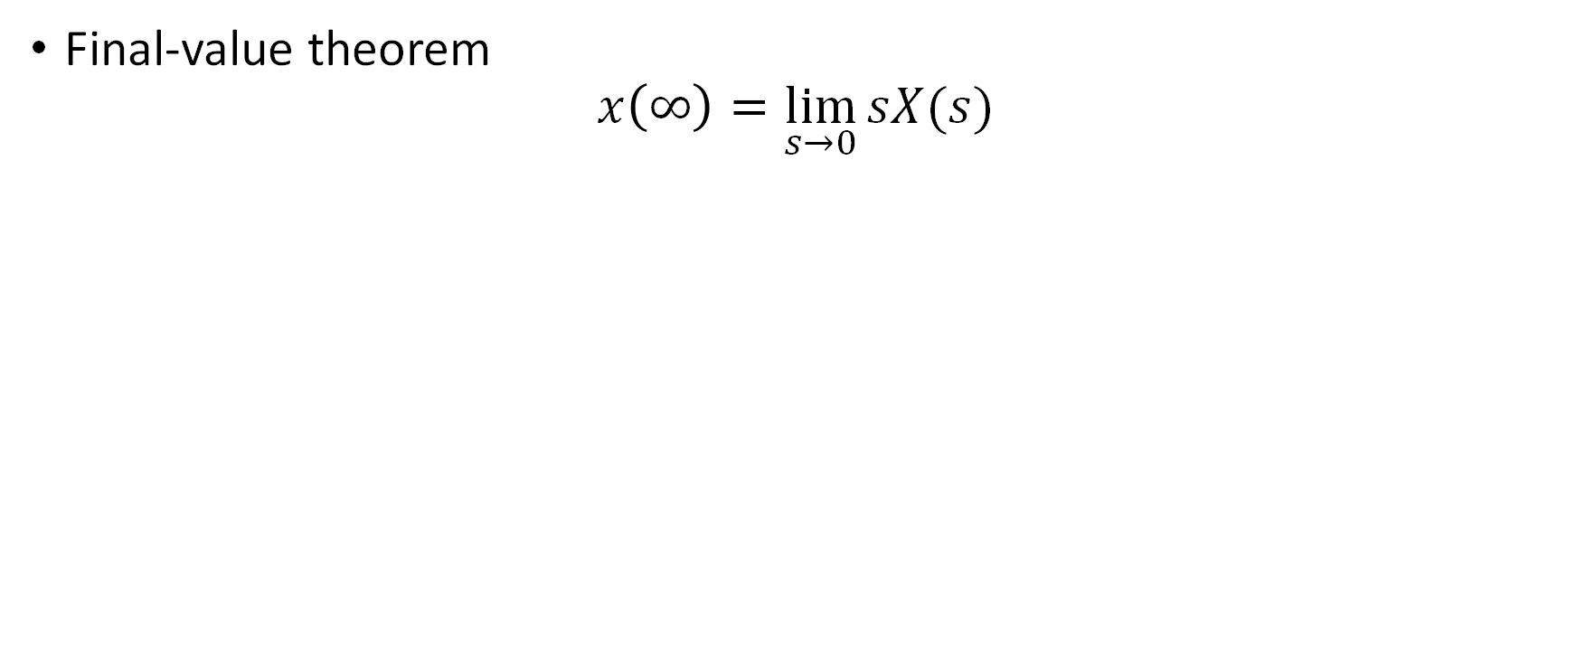
Properties of Laplace Transforms
Final-value theorem
$$x\left(∞\right)=\lim_{s→0}{sX(s)}$$
If $X(s)$ is rational, then for non-trivial output denominator should contain a factor of s.
$X\left(s\right)=\frac{a_{n−1}s^{n−1}+a_{n−2}s^{n−2}+…+a_{0}}{b_{n}s^{n}+b_{n−1}s^{n−1}+…+b_{1}s}$ implies $x\left(∞\right)=\frac{a_{0}}{b_{1}}$

Slide 52
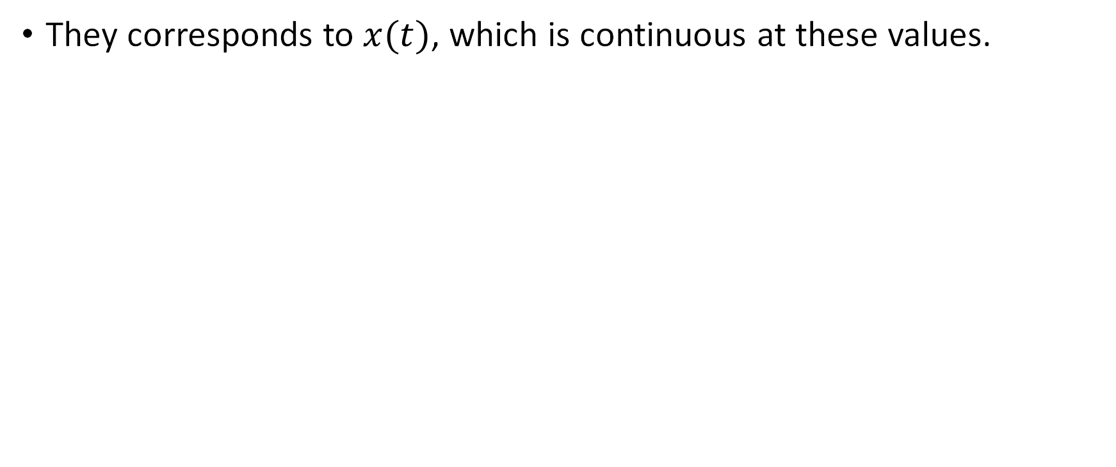
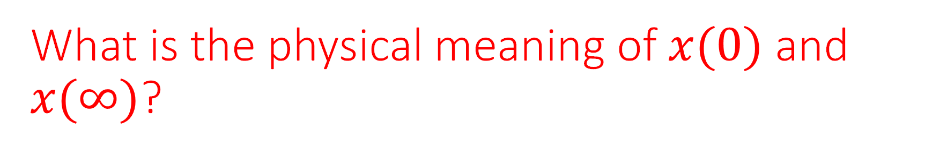
What is the physical meaning of $x(0)$ and $x(∞)$?
They corresponds to $x(t)$, which is continuous at these values.

Slide 53
Properties of Laplace Transforms
Output of an LTI system

Slide 54
Causal and Stable LTI system
Choose the right option
I) All poles lie in right-half plane
II) All poles lie in left-half plane
III) Poles can lie anywhere
IV) There are no poles at all
V) I do not care

Slide 55
Causal and Stable LTI system
Choose the right option
I) All poles lie in right-half plane
II) All poles lie in left-half plane
III) Poles can lie anywhere
IV) There are no poles at all
V) I do not care

Slide 56
Solving differential equation with Laplace transforms
A causal and stable LTI system with differential equation:
has the impulse response:
I | II
III | IV

Slide 57
Solving differential equation with Laplace transforms
√

Slide 58
Solving second-order differential equation with L-Transform

Slide 59
Solving second-order differential equation with L-Transform
For

Slide 60
Changing real part

Slide 69
Changing imaginary part

Slide 78
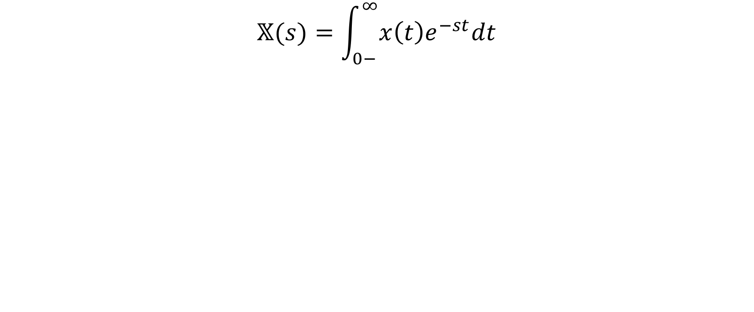
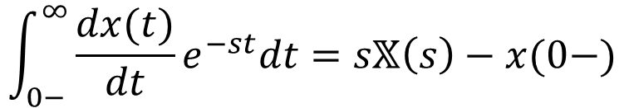
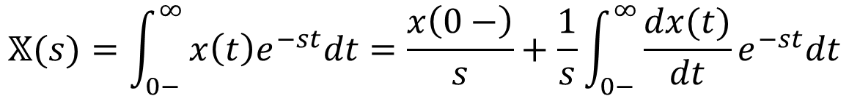
Unilateral Laplace Transform
$$𝕏(s)=\int_{0−}^{∞}{x\left(t\right)e^{−st}dt}$$
$$𝕏(s)=\int_{0−}^{∞}{x\left(t\right)e^{−st}dt=\frac{x\left(0−\right)}{s}+\frac{1}{s}\int_{0−}^{∞}{\frac{dx(t)}{dt}e^{−st}dt}}$$
$$\int_{0−}^{∞}{\frac{dx(t)}{dt}e^{−st}dt}=s𝕏\left(s\right)−x(0−)$$

Slide 79
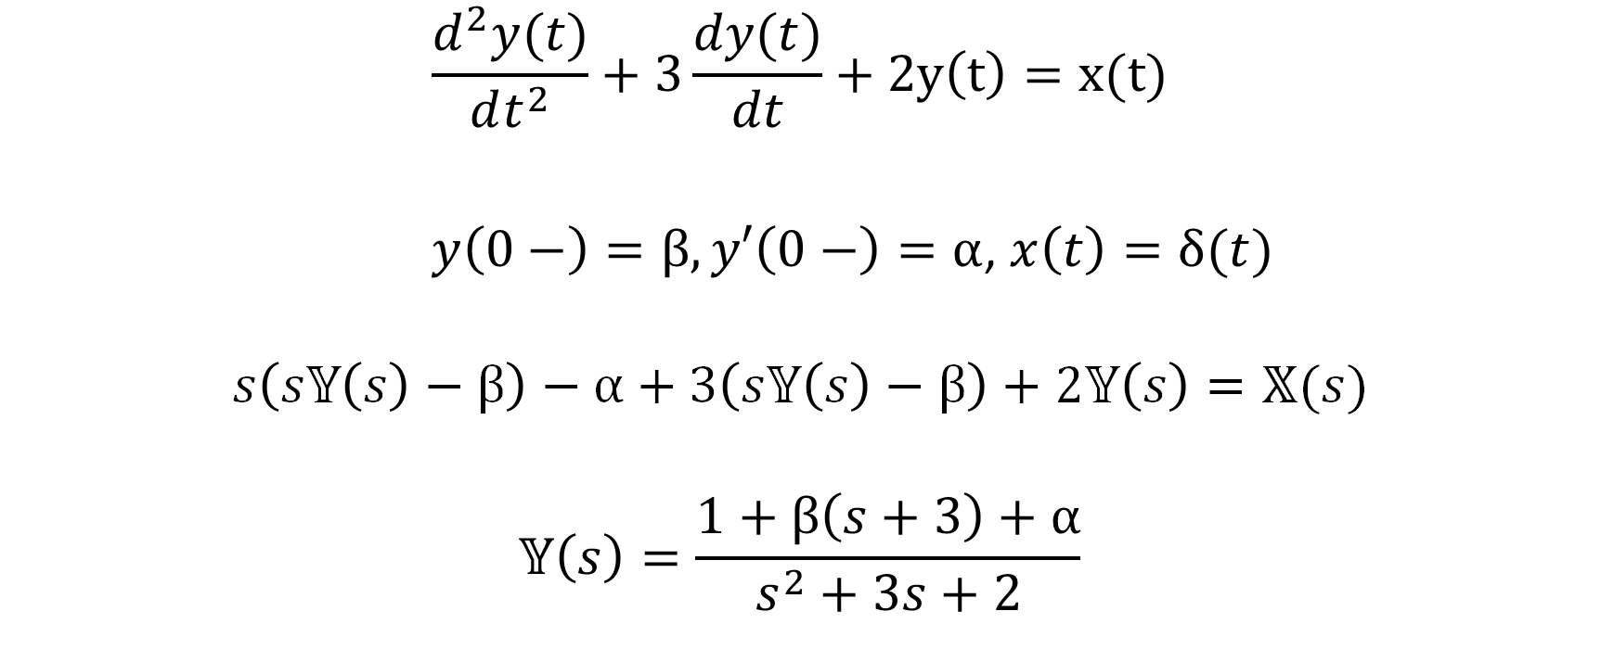
Solving DE
$$\frac{d^{2}y(t)}{dt^{2}}+3\frac{dy(t)}{dt}+2y\left(t\right)=x(t)$$
$y\left(0−\right)=β, y′\left(0−\right)=α$, $x\left(t\right)=δ(t)$
$$s\left(s𝕐\left(s\right)−β\right)−α+3\left(s𝕐\left(s\right)−β\right)+2𝕐\left(s\right)=𝕏(s)$$
$$𝕐\left(s\right)=\frac{1+β\left(s+3\right)+α}{s^{2}+3s+2}$$

